Slide 1
Automatic Ticketing System (ATS)
Group: SenseIT
Intelligent Buildings
Junction 2016

Slide 2
Opportunity

Slide 3
Solution Architecture
ATS
Database

Slide 4
Frontend - Manager

Slide 5
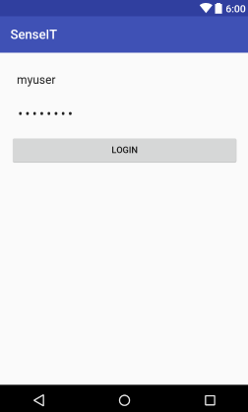
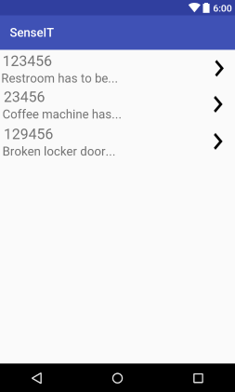
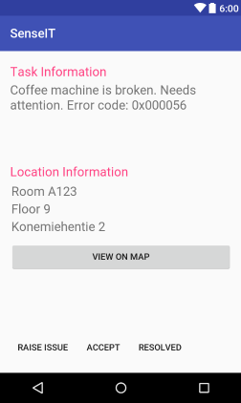
Frontend - Worker

Slide 6
Backend

Slide 7
Bounty

